Slide 1

Delivery Duration Prediction at Doordash
Final Project : Trisno Dwi Rahmanto

Slide 2
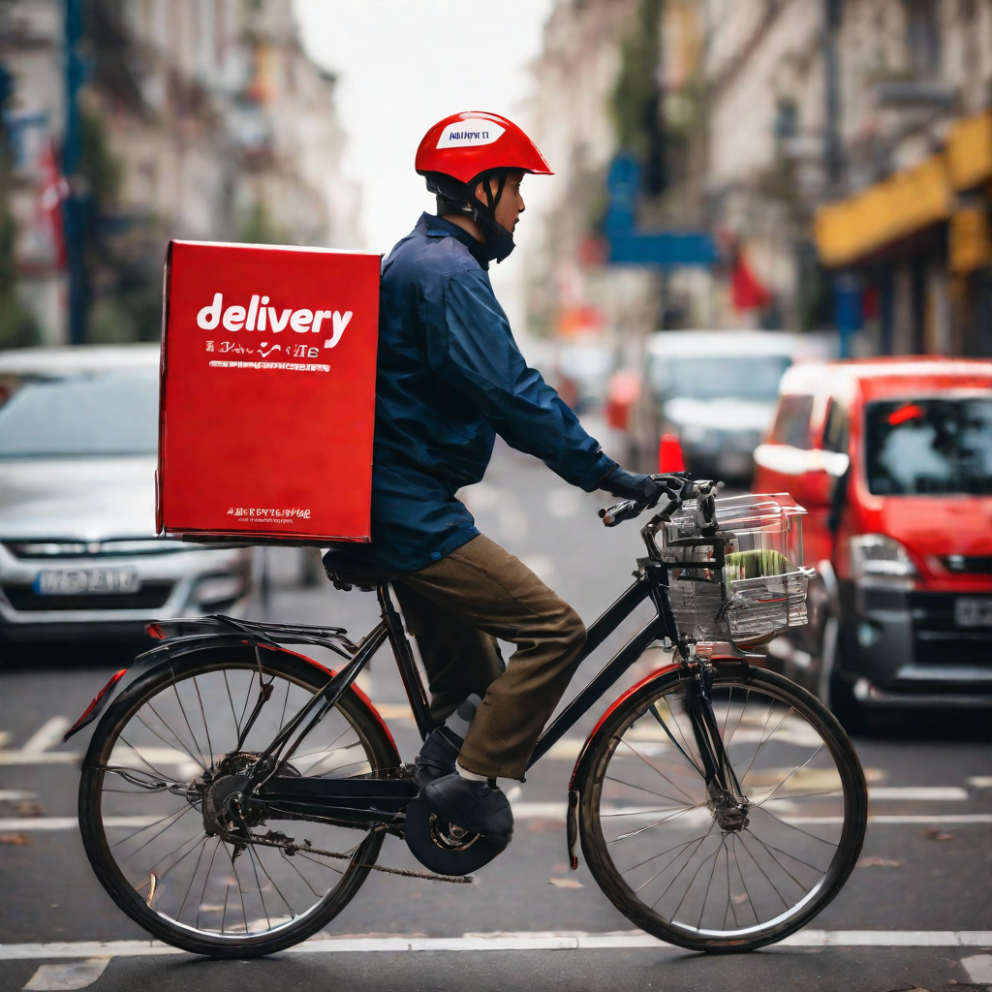
Outline
Data Background
Data Preprocesing and Analysis
Modelling
Result and Insight

Slide 3

Data Background

Slide 4
Background of DoorDash
DoorDash is a popular food delivery service that connects customers with local restaurants. It operates in more than 4,000 cities across the United States, Canada, and Australia, making over 5 million deliveries per month.
Delivery duration plays a crucial role in customer satisfaction and operational efficiency for DoorDash. Accurate predictions of delivery time help manage customer expectations, optimize driver assignments, and enhance overall service quality.

Slide 5
Overview of the presentation
Accurately predicting the delivery duration is crucial for ensuring customer satisfaction. It involves estimating the time it takes for an order to be delivered from the restaurant to the customer's location.
In my project the attached file historical_data.csv contains a subset of deliveries received at DoorDash in early 2015 in a subset of the cities. Each row in this file corresponds to one unique delivery. In the file added noise to the dataset to obfuscate certain business details. Each column corresponds to a feature as explained below. Note all money (dollar) values given in the data are in cents and all time duration values given are in seconds
This presentation aims to explore how DoorDash fine-tunes its efficiency by predicting delivery duration. We will delve into the factors affecting delivery duration, the predictive models used, the implementation process, and the impact on customer satisfaction and operational efficiency.

Slide 6
2. Data Preprocesing and Analysis

Slide 7



Data Information
197428
Rows
16
Features
1
Target

Slide 8
Features
Time
Order
Predict from other
market_id
created_at
actual_delivery_time
total_items
subtotal
num_distinct_item
min_item_price
max_item_price
estimated_order_place_duration
estimated_store_to_cunsomer_driving_duration
Store
Market
Target
store_id
store_primary_category
order_protocol
total_onshift_dashers
total_busy_dashers
total_outstanding_orders
duration

Slide 9
Missing Value
market_id
987 nan value
store_primary_category
4760 nan value
order_protocol
995 nan value
total_onshift_dashers
16262 nan value
total_busy_dashers
16262 nan value
total_outstanding_orders
16262 nan value
estimated_store_to_cunsomer_driving_duration
526 nan value
Data Cleaning
All features with missing value are remove
After data cleaning process, value data from 197428 rows to 175777 rows

Slide 10
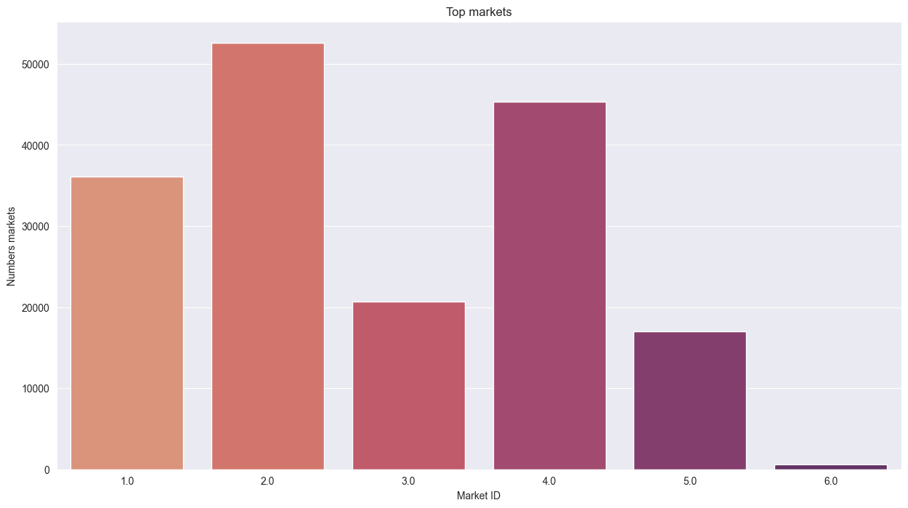
Data Analysis
Market Segment
A city/region in which DoorDash operates. Market_id 2 is most orders

Slide 11
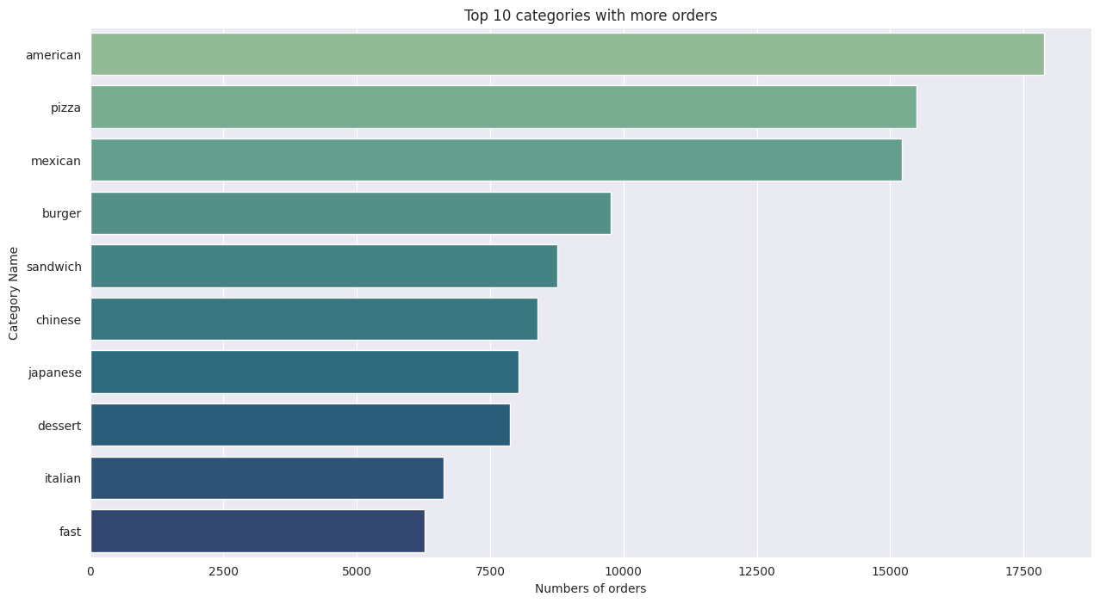
Data Analysis
Top Category with more order
American is the category with most order

Slide 12
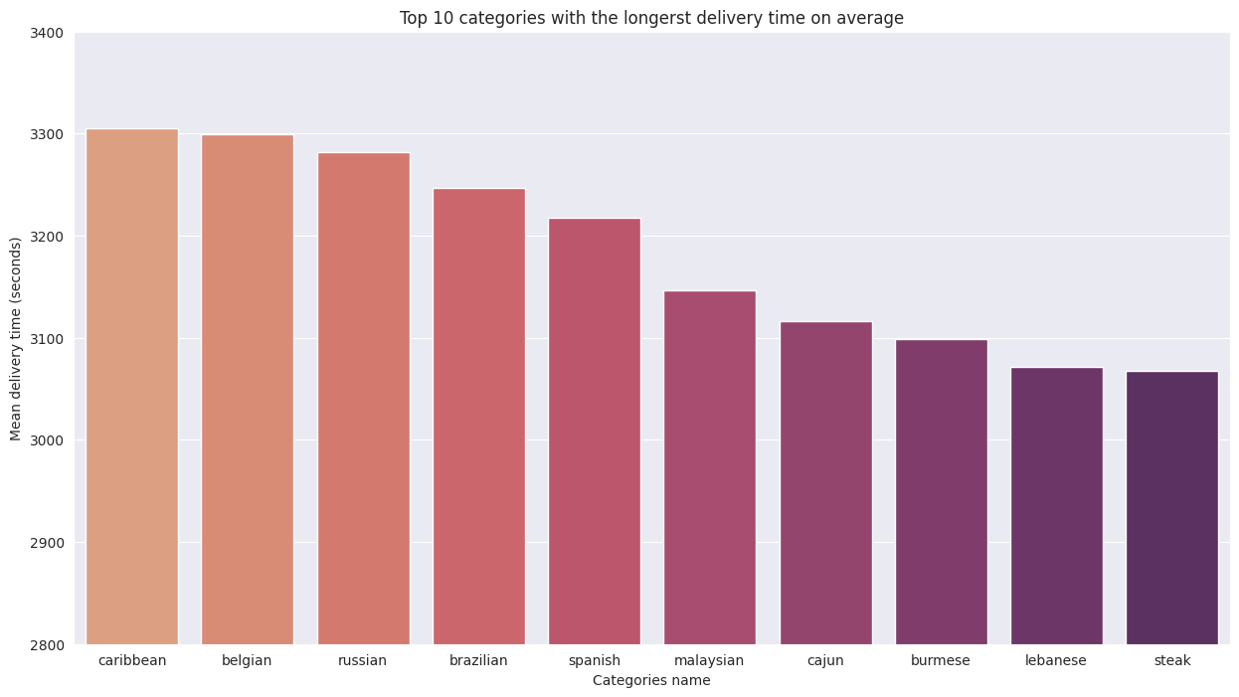
Data Analysis
Top Category with the longest delivery time
Caribbean is the category with longer delivery time on average

Slide 13
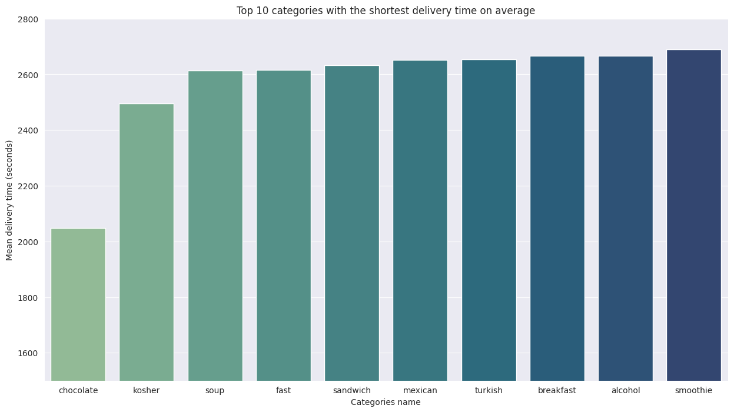
Data Analysis
Top Category with the shortest delivery time
Chocolate is the category with shortest delivery time on average

Slide 14
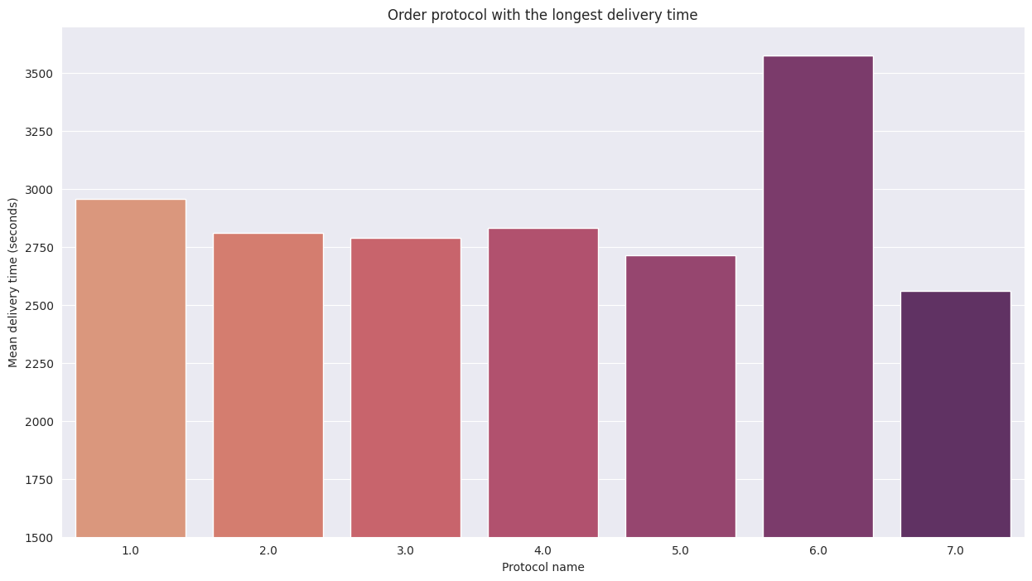
Data Analysis
Order protocol with the longest delivery time
Protocol order 6 is the protocol with longer delivery time on average

Slide 15
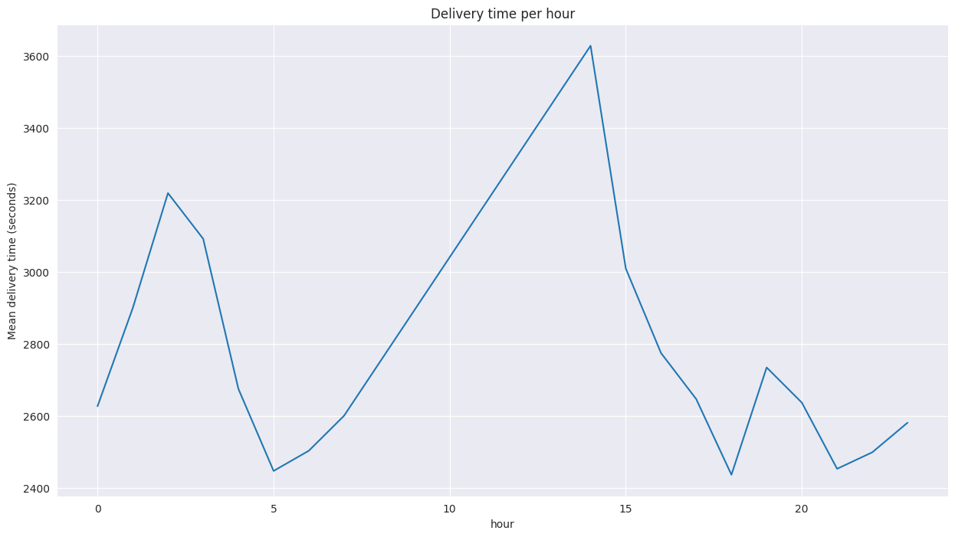
Data Analysis
Mean delivery time per hour of the day
02:00 PM is the hour that’s the delivery time on average is longer

Slide 16
Features Selection and Engineering
Some features that already covered by other features will be dropped
Categorical features transformed with Label Encoding
From
16 Features
After Encoding
98 Features

Slide 17
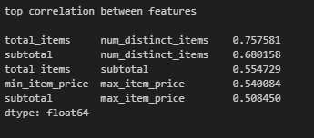
Analisys Multicollinearity
Some features with high correlation will be dropped
There is no high correlation between features

Slide 18
3. Modelling

Slide 19
Model Evaluation
We use evaluation metrics Rood Mean Squared Error to measure accuracy of the model’s prediction
The model we use is :
Random Forest Regressor
Random Forest Regressor with Randomized SearchCV
Gradien Boosting Regressor
Linear Regression
The predictor model using Random Forest with Randomized SearchCV that gave us a RMSE 845

Slide 20
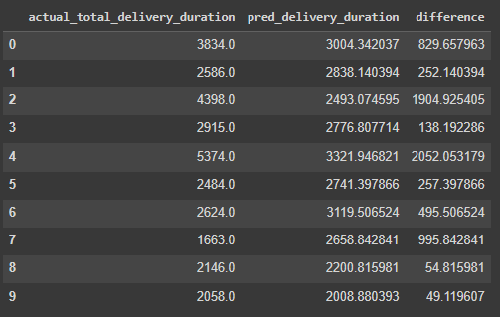
Model Implementation
With this project we can see the categories where the DashDoor takes longer to deliver your orders, besides it was possible to determine the time of day with the longest delay in the delivery of orders and the cities (market_id) as well.
From the prediction data obtained, the average is over prediction. So it would be better to create a buffer so that the predictions are more appropriate.

Slide 21
4. Result and Insight

Slide 22
Factors Impacting Delivery Duration
Through analyzing the results of the delivery duration prediction model, we have identified several factors that have the most impact on the delivery duration. These factors include:
Distance between the restaurant and the delivery location
Traffic conditions and congestion along the delivery route
Time of day and day of the week
Patterns and Trends in the Data
By analyzing the data, we have also identified several patterns and trends in the delivery duration. These insights can help us optimize our delivery operations and improve customer satisfaction. Some of the key patterns and trends include:
Delivery durations tend to be longer during peak hours and on weekends
Certain areas have consistently longer or shorter delivery durations

Slide 23
Thank You

